Slide 1
Lower Bound Theory
UNIT-5

Slide 2
Lower Bound Theory
Lower Bound Theory Concept is based upon the calculation of minimum time or minimum number of comparisons that is required to execute an algorithm is known as a lower bound theory or Base Bound Theory.
Concept/Aim: The main aim is to calculate a minimum number of comparisons required to execute an algorithm
LINK (more detail): Lower bound theory and introduction to parallel algorithm by Prof. Abhigyan / notations lower bound and upper bound
DAA Lower bound Theory - javatpoint

Slide 3
Lower Bound Theory uses a number of methods/techniques to find out the lower bound.

Slide 4
Techniques
Comparisons Trees.
Oracle and adversary argument
State Space Method

Slide 5
Comparison tree
UNIT-5

Slide 6
Comparison tree
A comparison tree, also known as a decision tree or binary search tree, is a fundamental data structure used in computer science and data analysis. It's often utilized in algorithms and data structures courses, as well as in various applications such as sorting, searching, and decision-making processes.

Slide 7
Here's a basic overview of how a comparison tree works:
Nodes: Each node in the tree represents an element or a decision point.
Edges: Edges connect the nodes and represent relationships between elements or decisions.
Root Node: The topmost node in the tree, from which all other nodes are descended.
Internal Nodes: Nodes in the tree that have child nodes.
Leaf Nodes: Nodes in the tree that do not have any child nodes. They represent the endpoints of the decision-making process.
Binary Tree: A type of comparison tree where each internal node has at most two child nodes.
Comparison Operation: At each internal node, a comparison operation is performed to determine which branch to follow based on the comparison result.

Slide 8
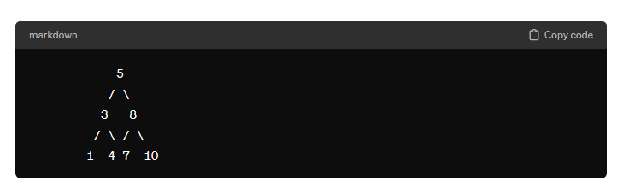
Here's an example of a simple comparison tree for sorting integers:
In this example, if you were to search for the number 4, you would start at the root (5), compare 4 with 5, then traverse to the left subtree since 4 is less than 5, then compare 4 with 3, and finally find 4 in the left subtree of 3.

Slide 9
Comparison trees can be used for various purposes, including:
Searching: Binary search trees are particularly efficient for searching operations.
Sorting: Techniques like binary tree sort can be implemented using comparison trees.
Decision Making: Decision trees are a specific type of comparison tree used for decision-making processes in machine learning and artificial intelligence.
AVL Tree , Splay Tree( comparison example), Balanced m-way tree (comparison example ) ,Red black tree
Overall, comparison trees are versatile data structures that are widely used in computer science and data analysis due to their efficiency and simplicity.

Slide 10
Decision Making
In data structures, a "decision tree" typically refers to a tree-like structure used for decision-making or classification purposes. It's not to be confused with the "decision tree" used in algorithm analysis, which was mentioned earlier in the context of lower bound theory.
Decision Making is a FULL BINARY TREE that shows the comparisons between elements that are executed by appropriate sorting algorithm operating on an input of given size.

Slide 11
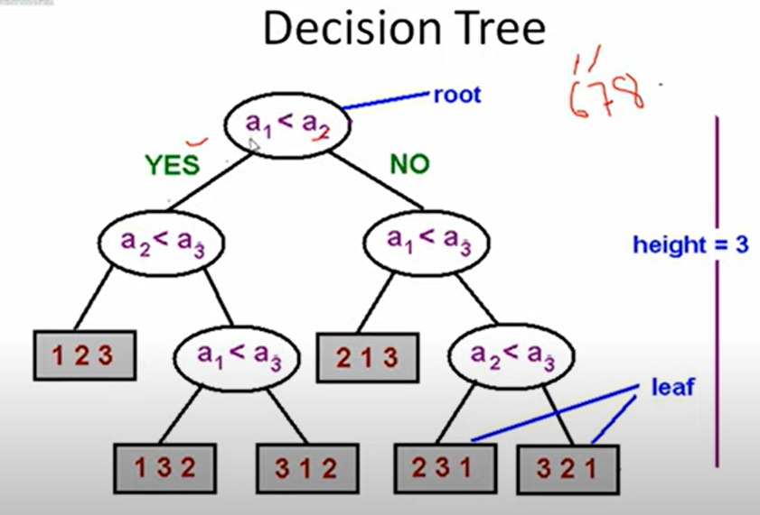
Decision trees

Slide 12
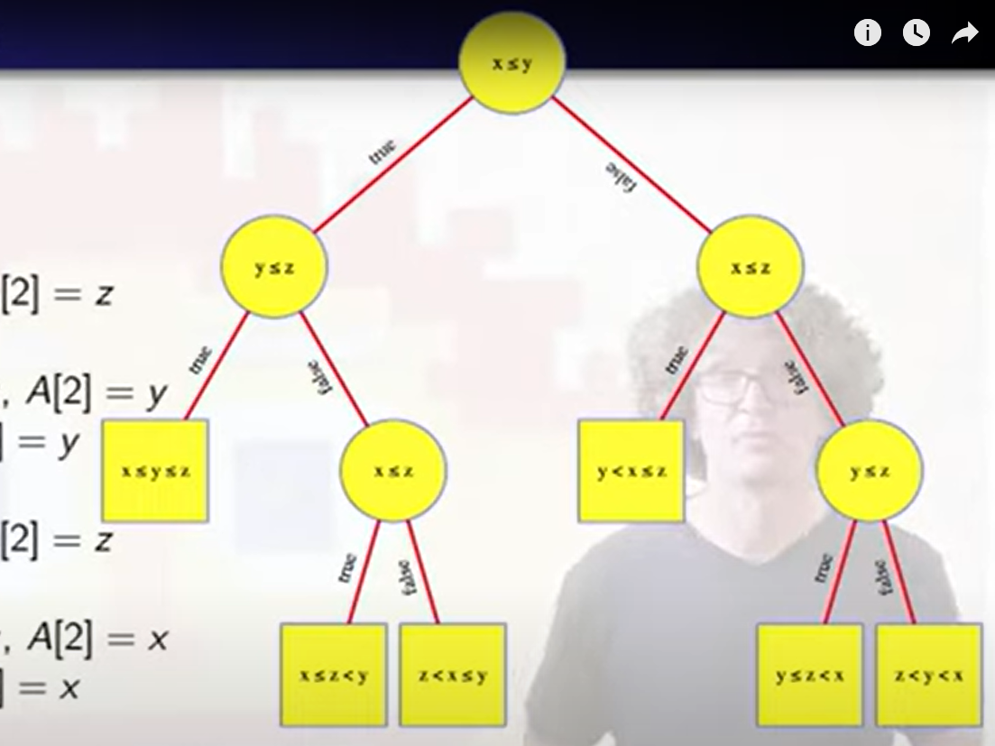
COMPARE 3 ELEMENTS

Slide 13
1. Comparison trees:
In a comparison sort, we use only comparisons between elements to gain order information about an input sequence (a1; a2......an).
Given a_{i},a_{j} from (a₁, a₂.....a_{n})We Perform One of the Comparisons
a_{i} < a_{j} less than
a_{i} ≤ a_{j} less than or equal to
a_{i} > a_{j} greater than
a_{i} ≥ a_{j} greater than or equal to
a_{i} = a_{j} equal to
To determine their relative order, if we assume all elements are distinct, then we just need to consider a_{i} ≤ a_{j} '=' is excluded &, ≥,≤,>,< are equivalent.
Consider sorting three numbers a1, a2, and a3. There are 3! = 6 possible combinations:
(a1, a2, a3), (a1, a3, a2),
(a2, a1, a3), (a2, a3, a1)
(a3, a1, a2), (a3, a2, a1)
The Comparison based algorithm defines a decision tree.

Slide 14
Decision Tree:
Decision Tree: A decision tree is a full binary tree that shows the comparisons between elements that are executed by an appropriate sorting algorithm operating on an input of a given size. Control, data movement, and all other conditions of the algorithm are ignored.

Slide 15
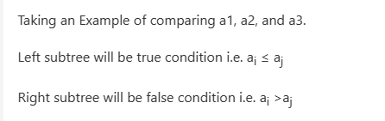
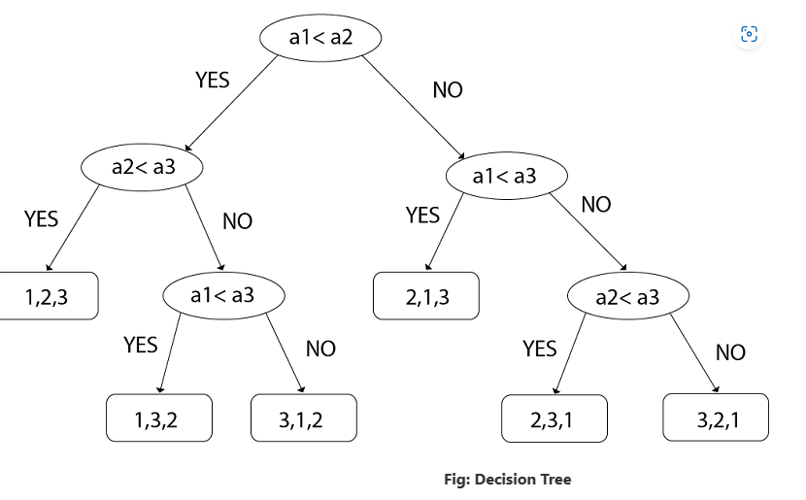

Slide 16
Comparison tree for Binary Search:
Example: Suppose we have a list of items according to the following Position:

Slide 17
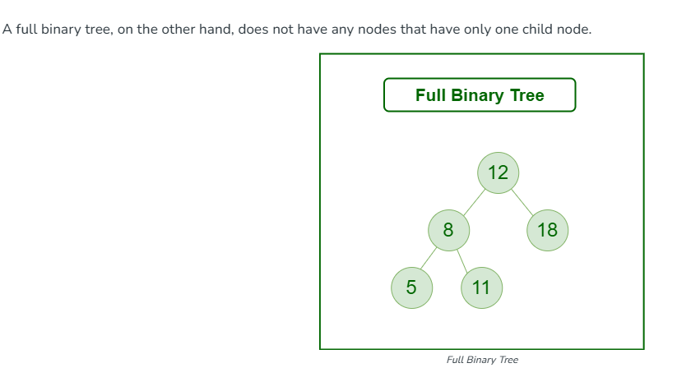
What is a Full Binary Tree?
A full binary tree is a binary tree with either zero or two child nodes for each node.

Slide 18
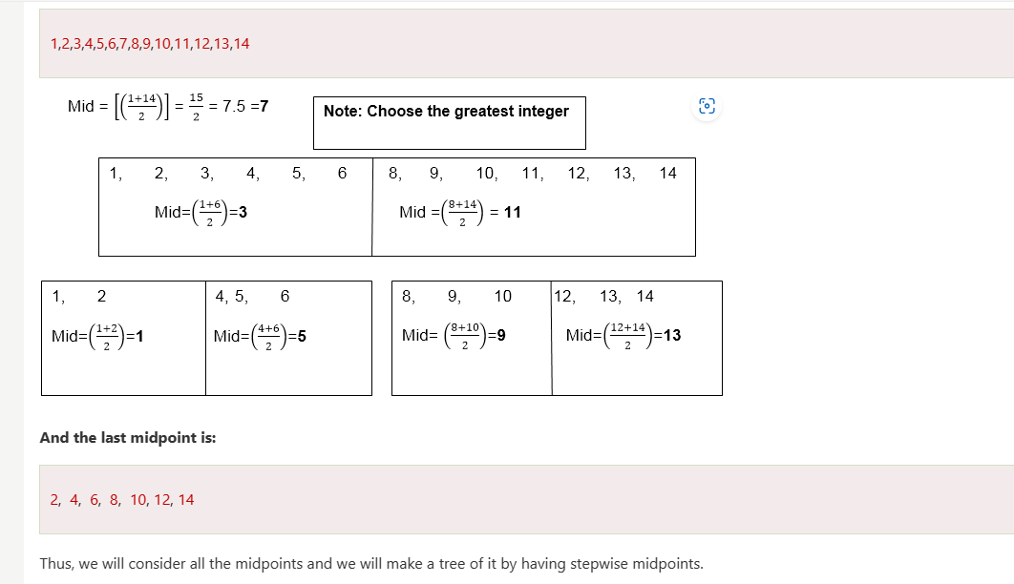

Slide 19
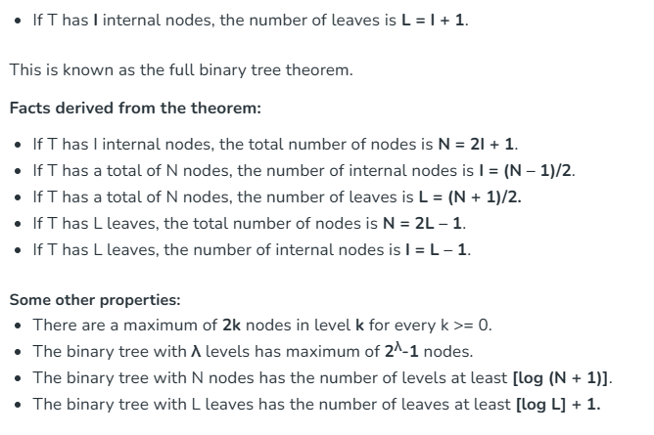

Slide 20
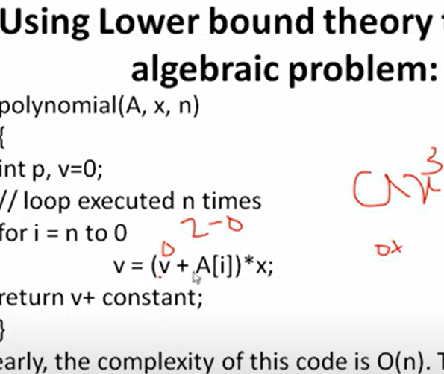
Techniques for algebraic problem

Slide 21
FOR MORE DETAIL
Lower bound theory and introduction to parallel algorithm by Prof. Abhigyan (youtube.com)
DAA Lower bound Theory - javatpoint

Slide 22
Oracle and adversary argument
UNIT-5

Slide 23
In summary, oracles and adversary arguments are complementary techniques used in the analysis of algorithms. Oracles help establish lower bounds by assuming the existence of efficient solutions, while adversary arguments are used to derive upper bounds by considering the worst-case behavior against a strategically chosen opponent. Together, they provide insights into the fundamental limits and capabilities of algorithms.

Slide 24
https://www.youtube.com/watch?v=hz3-YUNf3Y4
Javatpooint
Chatgpt

Slide 25
oracle and adversory Example: (Merging Problem)
Example: (Merging Problem) given the sets A (1: m) and B (1: n), where the information in A and in B are sorted. Consider lower bounds for algorithms combining these two sets to give an individual sorted set.
Consider that all of the m+n elements are specific and A (1) < A (2) < ....< A (m) and B (1) < B (2) < ....< B (n).

Slide 26
Solution acc to oracle & advisory approach
Let's break down the problem of merging two sorted sets A and B into a single sorted set using an oracle and adversary argument. We'll consider both upper and lower bounds on the number of comparisons required by any comparison-based merging algorithm.
Given two sorted sets A and B, each with m and n elements respectively, the goal is to merge them into a single sorted set.

Slide 27
Oracle Approach (Lower Bound):
Assume we have an oracle that instantly tells us the correct position to insert an element into the merged set, given its value and the current state of the merged set.
With this oracle, we can guarantee that we'll need at leastm+n−1 comparisons to merge the two sets. This is because each element from A or B needs to be compared at least once with another element from the other set.
For example, if A has m elements and B has n elements, then there are m+n−1 positions where elements from both sets will be compared.
This lower bound of m+n−1 comparisons is achievable only with the help of the oracle, as it assumes we have perfect knowledge about where each element should be placed.

Slide 28
EXAMPLE
LETS A={10 ,20 ,30 ,100 } , B={5 ,8, 80, 90 }
// Merge elements from A and B into mergedArray until one of the arrays is exhausted while (i < m && j < n)
{ if (A[i] <= B[j])
{ merged[k] = A[i]; i++; }
else { merged[k] = B[j]; j++; }
k++;
}

Slide 29
#include <iostream>
void mergeSortedArrays(int A[], int m, int B[], int n, int merged[]) {
int i = 0, j = 0, k = 0;
// Merge elements from A and B into mergedArray until one of the arrays is exhausted
while (i < m && j < n) {
if (A[i] <= B[j]) {
merged[k] = A[i];
i++;
} else {
merged[k] = B[j];
j++;
}
k++;
}
// Append remaining elements from A, if any
while (i < m) {
merged[k] = A[i];
i++;
k++;
}
// Append remaining elements from B, if any
while (j < n) {
merged[k] = B[j];
j++;
k++;
}
}
int main() {
// Example arrays A and B (sorted)
int A[] = {1, 3, 5, 7, 9};
int m = sizeof(A) / sizeof(A[0]);
int B[] = {2, 4, 6, 8, 10};
int n = sizeof(B) / sizeof(B[0]);
// Size of merged array
int mergedSize = m + n;
int merged[mergedSize];
// Merge the arrays
mergeSortedArrays(A, m, B, n, merged);
// Print the merged array
std::cout << "Merged Array: ";
for (int i = 0; i < mergedSize; i++) {
std::cout << merged[i] << " ";
}
std::cout << std::endl;
return 0;
}

Slide 30
Adversary Argument (Upper Bound):
Now, let's consider an adversary that strategically selects elements from sets A and B to maximize the number of comparisons required by any merging algorithm.
The adversary's goal is to force the merging algorithm to make as many comparisons as possible.
One strategy the adversary might use is to alternate between selecting elements from sets A and B in such a way that the merging algorithm is forced to compare every element with every other element, leading to m×n comparisons.
However, with careful consideration, it can be shown that the upper bound on the number of comparisons is m×n.
This upper bound of m×n comparisons is achieved in the worst-case scenario, where every element in A is compared with every element in B.

Slide 31
SUMMARY /NOTE
In summary, the lower bound provided by the oracle tells us that at least m+n−1 comparisons are required, assuming perfect knowledge. On the other hand, the upper bound derived from the adversary argument tells us that in the worst-case scenario, m×n comparisons may be needed. These bounds help us understand the range of comparisons required by any comparison-based merging algorithm, considering both ideal and worst-case scenarios.

Slide 32
Lower Bounds through Reductions
UNIT-5

Slide 33
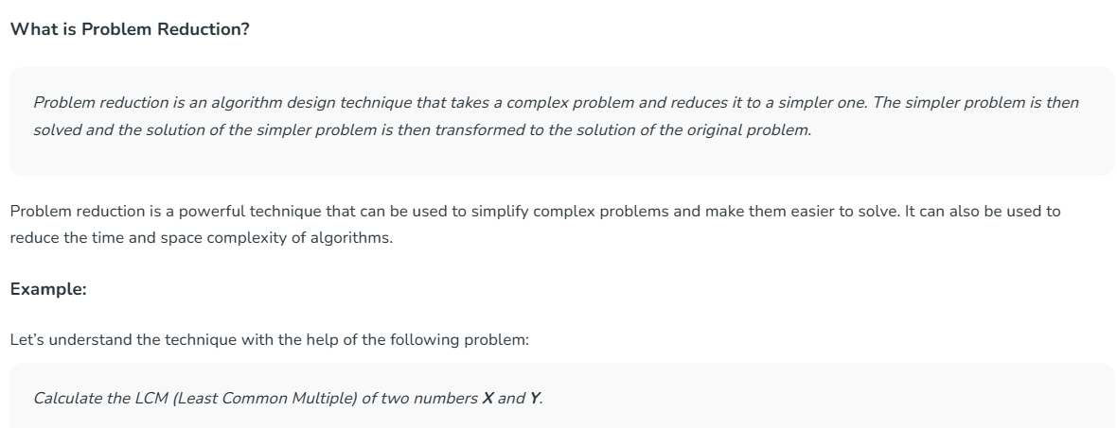

Slide 34
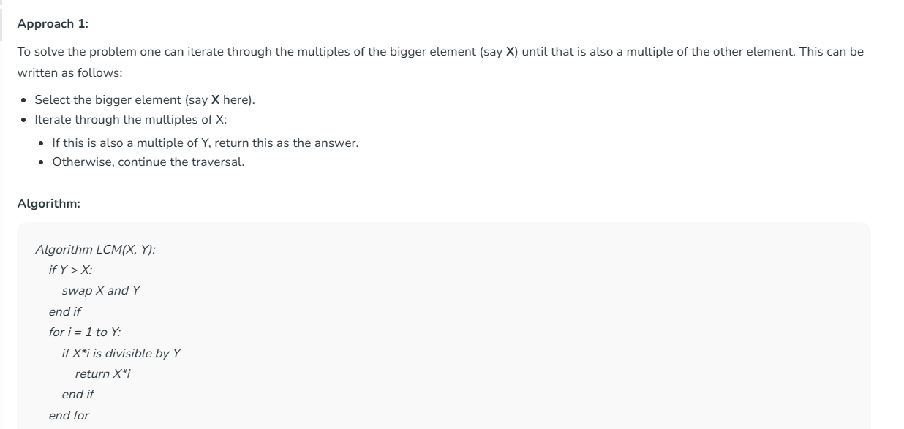

Slide 35
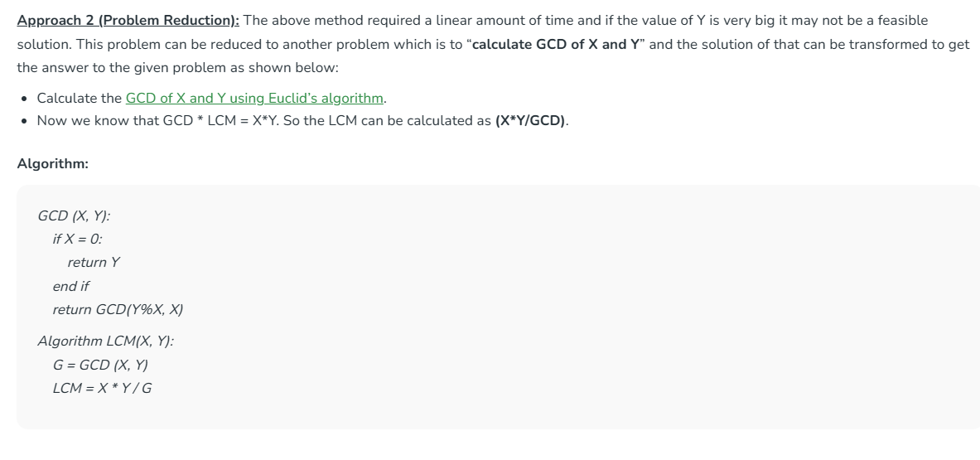
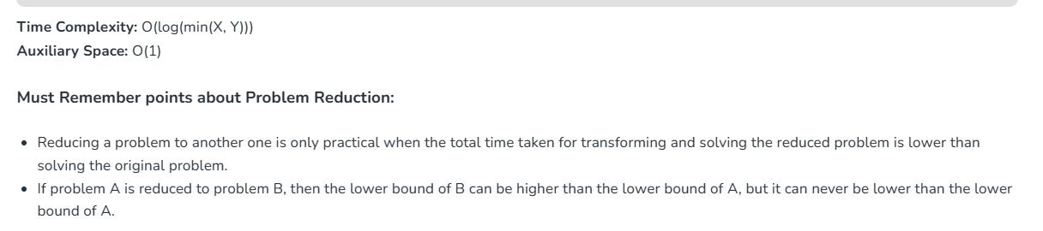

Slide 36
Lower Bounds through Reductions
In the context of Design and Analysis of Algorithms (DAA), lower bounds through reductions involve proving that a certain problem is at least as hard as another problem for which a lower bound is known. This technique is commonly used to establish lower bounds on the time complexity of algorithms.

Slide 37
Here's how lower bounds through reductions work:
Definition: Lower bounds through reductions involve showing that solving Problem A requires at least as much time (or resources) as solving Problem B, for which a lower bound is already known.
Technique: This technique relies on reducing Problem B to Problem A, meaning that an algorithm that solves Problem A can also be used to solve Problem B efficiently. If Problem B has a known lower bound, then this implies that Problem A also has at least the same lower bound.

Slide 38
Examples:
If we can show that sorting a list of numbers requires at least Ω(nlog⁡n)Ω(nlogn) comparisons, then any problem reducible to sorting (such as finding the median or finding the kth smallest element) will also have a lower bound of Ω(nlog⁡n)Ω(nlogn).
Lower bounds on problems like matrix multiplication, graph connectivity, or searching algorithms can also be established through reductions from well-known problems with known lower bounds.

Slide 39
Certainly! Let's consider another example where we establish a lower bound on the time complexity of a problem by reducing it to the problem of sorting.

Slide 40
Here's how we can prove this using the same logic as before:
Reduction to Sorting:
We can reduce the problem of finding the maximum element to sorting by observing that once the array is sorted in non-decreasing order, the maximum element will be at the last index of the sorted array.
Therefore, if we can prove a lower bound on the number of comparisons required for sorting, it will imply a lower bound on the number of comparisons required to find the maximum element.
Lower Bound on Sorting:
From the comparison-based sorting lower bound theorem, we know that any comparison-based sorting algorithm requires at least Ω(nlogn) comparisons in the worst case.
Since finding the maximum element can be reduced to sorting, it follows that any algorithm for finding the maximum element must also perform at least Ω(nlogn) comparisons in the worst case.

Slide 41
Here's how we can prove this using the same logic as before:
Reduction to Sorting:
We can reduce the problem of finding the maximum element to sorting by observing that once the array is sorted in non-decreasing order, the maximum element will be at the last index of the sorted array.
Therefore, if we can prove a lower bound on the number of comparisons required for sorting, it will imply a lower bound on the number of comparisons required to find the maximum element.
Lower Bound on Sorting:
From the comparison-based sorting lower bound theorem, we know that any comparison-based sorting algorithm requires at least Ω(nlogn) comparisons in the worst case.
Since finding the maximum element can be reduced to sorting, it follows that any algorithm for finding the maximum element must also perform at least Ω(nlogn) comparisons in the worst case.

Slide 42
EXAMPLE2 : Here's how we can prove this using the same logic as before:
Reduction to Sorting:
We can reduce the problem of finding the maximum element to sorting by observing that once the array is sorted in non-decreasing order, the maximum element will be at the last index of the sorted array.
Therefore, if we can prove a lower bound on the number of comparisons required for sorting, it will imply a lower bound on the number of comparisons required to find the maximum element.
Lower Bound on Sorting:
From the comparison-based sorting lower bound theorem, we know that any comparison-based sorting algorithm requires at least Ω(n) comparisons in the worst case.
Since finding the maximum element can be reduced to sorting, it follows that any algorithm for finding the maximum element must also perform at least Ω(n) comparisons in the worst case.

Slide 43
Reduction to Sorting (sorting then find largest elemnt ):
We can reduce the problem of finding the maximum element to sorting by observing that once the array is sorted in non-decreasing order, the maximum element will be at the last index of the sorted array.
Therefore, if we can prove a lower bound on the number of comparisons required for sorting, it will imply a lower bound on the number of comparisons required to find the maximum element.
Find largest element in array (First sort elemnts then find largest )
Let us assume : int a[6] = {10 , 5, 20 , 100 ,9 ,21 }
for(i=0;i<sizeofarray ;i++)
{
if(a[i]>a[i+1])
{
temp=a[i]
a[i]=a[i+1] Total Comparisons are : n-1 where n= total no of elemnts
a[i+1]=temp
}
}
cout<<a[n]

Slide 44
Lower Bound on Sorting(directly find largest element without sorting ):
From the comparison-based sorting lower bound theorem, we know that any comparison-based sorting algorithm requires at least Ω(n) comparisons in the worst case.
Since finding the maximum element can be reduced to sorting, it follows that any algorithm for finding the maximum element must also perform at least Ω(n) comparisons in the worst case.
Let us assume : int a[6] = {10 , 5, 20 , 100 ,9 ,21 }
max=10
for(i=1;i<sizeofarray ;i++)
{
if(max<a[i])
{
max=a[i] Total Comparisons are : n-1 where n= total no of elemnts
}
}

Slide 45
Conclusion:
Therefore, we have established that finding the maximum element in an unsorted array requires at least Ω(n-1) comparisons in the worst case, based on the lower bound for sorting.
This result implies that any problem reducible to finding the maximum element (such as finding the minimum or the kth smallest element) will also have a lower bound of Ω(n-1) comparisons in the worst case.

Slide 46
summary
In summary, by showing that the problem of finding the maximum element can be reduced to sorting, and using the lower bound for sorting, we establish a lower bound on the number of comparisons required for finding the maximum element, as well as for any problem reducible to it.

Slide 47
Problem Reduction in Transform and Conquer Technique - GeeksforGeeks

Slide 48
Approximate Algorithms / heuristic algorithm
Approximation algorithms in Design and Analysis of Algorithms (DAA) are algorithms that efficiently find solutions to optimization problems, providing solutions that are close to optimal within a guaranteed factor. These algorithms are particularly useful for problems where finding the exact optimal solution is computationally infeasible, especially in cases where the problems are NP-hard or NP-complete.(example apa kehnde haan k 6.78 ans aya means approximate aya , 6 ja 7 h pura exact nhi aya )
An Approximate Algorithm is a way of approach NP-COMPLETENESS for the optimization problem. This technique does not guarantee the best solution. The goal of an approximation algorithm is to come as close as possible to the optimum value in a reasonable amount of time which is at the most polynomial time. Such algorithms are called approximation algorithm or heuristic algorithm.

Slide 49
Example’s / VIMP
For the traveling salesperson problem, the optimization problem is to find the shortest cycle, and the approximation problem is to find a short cycle.
For the vertex cover problem, the optimization problem is to find the vertex cover with fewest vertices, and the approximation problem is to find the vertex cover with few vertices.
Suppose we work on an optimization problem where every solution carries a cost(size/time ). An Approximate Algorithm returns a legal solution, but the cost of that legal solution may not be optimal.

Slide 50
Here are some key/IMP aspects of approximation algorithms:
Greedy Algorithms: Many approximation algorithms use greedy strategies to construct solutions iteratively. Greedy algorithms make locally optimal choices at each step with the hope that the overall solution will be close to optimal. While greedy algorithms do not always guarantee the best possible solution, they can be efficient and provide good approximations for certain problems.
Examples: Approximation algorithms are used to solve a wide range of optimization problems, including the traveling salesman problem (TSP), the knapsack problem, vertex cover, set cover, facility location, and more.
Trade-offs: Approximation algorithms involve trade-offs between solution quality and computational efficiency. By sacrificing optimality for efficiency, approximation algorithms enable the solution of large-scale optimization problems that would otherwise be intractable.
In summary, approximation algorithms are an essential tool in algorithm design and analysis, providing practical solutions to optimization problems with guaranteed bounds on solution quality. They play a crucial role in addressing complex computational challenges in various fields, including computer science, operations research, and engineering.

Slide 51
summary
In summary, approximation algorithms are an essential tool in algorithm design and analysis, providing practical solutions to optimization problems with guaranteed bounds on solution quality. They play a crucial role in addressing complex computational challenges in various fields, including computer science, operations research, and engineering.

Slide 52
Performance Ratios
Suppose we work on an optimization problem where every solution carries a cost(size/time ). An Approximate Algorithm returns a legal solution, but the cost of that legal solution may not be optimal.

